Slide 1


Overview and Introduction
2021
Brought to you by authorised agent recruitment-tests.co.uk

Slide 2

WHAT IS THE CAMBRIDGE CODE (TCC)?
A new psychometric tool that assesses subconscious drivers of behaviours
in a cost-effective and scalable way
Quick and easy diagnostic
Online assessment reveals what would take 6-8 sessions with an occupational psychologist
Rigorous testing and validation
Developed with Cambridge University, including 4 stages of trials and live-trial validation at Harvard
Assesses the subconscious
Assesses subconscious traits and characteristics that are not readily identifiable
Clear and practical output
Clear results that are easy to use and do not require specialist interpretation
Brought to you by authorised agent recruitment-tests.co.uk and iiop.co.uk
2

Slide 3





WHY IS TCC DIFFERENT?
Bringing TCC to life
Goes beyond visible behaviours (i.e. the focus of most existing psychometrics)
Existing psychometrics
E.g.
Assess observable reported behaviours (i.e. “what” people do that can be seen by others)
Unpicks the “why” that sits behind these behaviours by assessing the subconscious
Imagine what you see when you first look at a tree – the colour of leaves, the size and shape of the branches. This how the tree presents itself to the world…
Uses a unique methodology to remove bias (self and observed) and see the “true” individual
The Cambridge Code
The Cambridge Code online assessment
Assesses the subconscious that is hidden (i.e. “why” an individual behaves in this way)
Self-guided questionnaire
49 multiple choice questions
Takes c.20 minutes to complete
Results generated automatically
Now think about the underlying reasons why the tree may look as it does – why is it the tallest? Why is a certain colour? Why could it weather a storm? This is down to things not visible externally – e.g. roots and the soil
3
Brought to you by authorised agent recruitment-tests.co.uk and iiop.co.uk

Slide 4

TCC CAREERS CHARACTERISTICS
DRIVE
Does this person have access to strong inner ambition and drive that will lead to their fulfilment?
POTENTIAL
Does this person keep striving to improve, learn and enrich themselves?
TEAMWORK
How naturally competitive does this person feel towards others?
CONTROLLED
Does this person show and communicate an authentic version of themselves to others?
RISK APPETITE
Does this person have an unhealthy appetite for risk taking?
TRANSPARENCY
Does this person have a subconscious desire to hide mistakes or make things look better than they are?
TENACITY
Can this person bounce back from a knock or a set-back and support others in a crisis?
SELF-SUFFICIENCY
How independent is this person and does this disconnect them from others?
REASSURANCE
Does this person need support from an organisation and do they value encouraging messaging?
AUTHORITY
Does this person consistently have problems with others who hold positions of authority and resent directional messaging?
DECISIVENESS
Does this person wait too long, garner too many opinions or not ‘take the bull by the horn themselves?
LEADERSHIP
Does this person show compassion in their interaction with others and see the consequences of their actions?
INTEGRITY
Does this person have an upright, honest approach?
FLEXIBILITY
How black and white or flexible is this person’s approach to life?
4
Brought to you by authorised agent recruitment-tests.co.uk and iiop.co.uk

Slide 5


BENEFITS OF USING TCC FOR RECRUITMENT
Allows the client to have a ‘snap shot’ of underlying drivers to behaviours that cannot be spotted at interview. What you see is not always what you get – TCC shows what a candidate really has in their core.
Provides the candidate with immediate feedback and tips for their own development.
Removes bias from an interview process.
Allows you to see whether someone can tap into or has innate drive and potential.
Flags any risk profiles around team behaviours, resilience and risk taking.
Can feed into ongoing personal development plans for successful hires.
5
Brought to you by authorised agent recruitment-tests.co.uk and iiop.co.uk

Slide 6



































SUMMARY OF OUR EXPERIENCE
TCC has worked with a wide range of Companies and Government departments, across a range of functions, industries and countries
Government departments and regulatory bodies
Financial and professional services
Sample international clients
Other selected experience
Higher education
6
Brought to you by authorised agent recruitment-tests.co.uk and iiop.co.uk

Slide 7
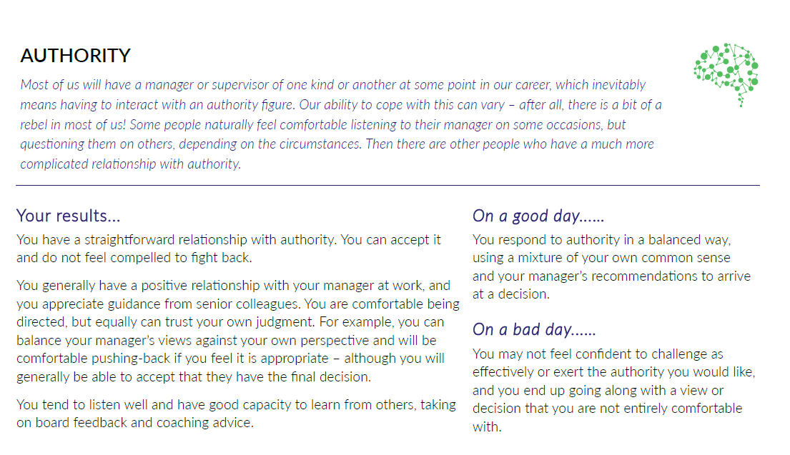

COST & SAMPLE OUTPUT
Service
Description
Price
TCC Careers Report
Individuals complete TCC online assessment and automatically receive personal report (if desired), along with access to digital support materials (e.g. podcasts). Client is sent candidate report to inform decision making.
£62
Only at www.recruitment-tests.co.uk
Sample Output For Authority

